Slide 1
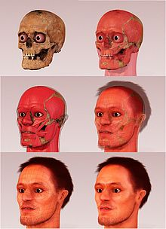
X. Facial Reconstruction
Skull can be scanned into a computer
“Fleshed" to give likely facial appearance
Eye color, nose, hair color & lips are indep. of bony structure.
decompose

Slide 2
Reconstruction Story
Pearl was a female who died in her early forties
300 years ago.
Caucasian, European ancestry, & 5'1".
Extremely poor dental health
She had lost 63% of her teeth.
She had no teeth on either side of her jaw.
Her loss of teeth = evidence of sunken cheeks during reconstruction.
There were indicators that she suffered from acute infections, rickets, sinusitis, an upper respiratory infection, arthritis, and gout.
Poor girl… all this an aspirin didn’t even exist!!
On the other hand, it was determined that she was very muscular, as the ridges on her long bones were very developed.

Slide 3
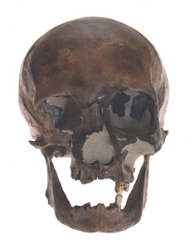
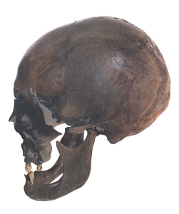

Slide 4
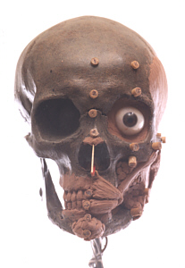
The artist utilized proper tissue depth data determined by race, gender, and age.
Artificial eyes were placed in the skull’s eye sockets, centered and at the proper depth.
The tissue markers were glued directly onto the skull.
Clay was systematically applied directly on the skull, following the skull's contours; paying strict attention to the applied tissue markers.

Slide 5
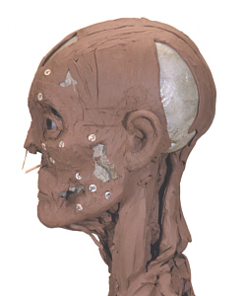
Various measurements:
nose thickness/length
mouth thickness/width
eye placement
Geographic location, lifestyle, & various info provided to the artist by the For. Anthropologist & other professionals
Important in completing reconstruction.

Slide 6
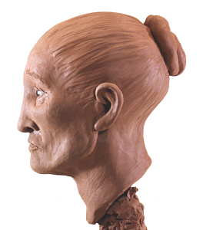
This woman had missing side teeth & a small jaw.
Hair is added by applying clay or a wig.
Various items (glasses, clothing, hats) may be applied to better accentuate the features of the individual.
Very successful method!!

Slide 7
Cause of Death
Anthropologists can distinguish btw marks from the result of a weapon attack & those resulting from animals gnawing & biting of bones.
They can also determine the exact kind of weapon & animal, and if it is an old wound or occurred at death.
They can be called upon to testify as to the type of weapon used (saw vs. knife).

Slide 8
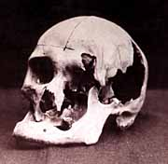
Lizzie Bordon’s Father’s skull: Ax Whacked.

Slide 9
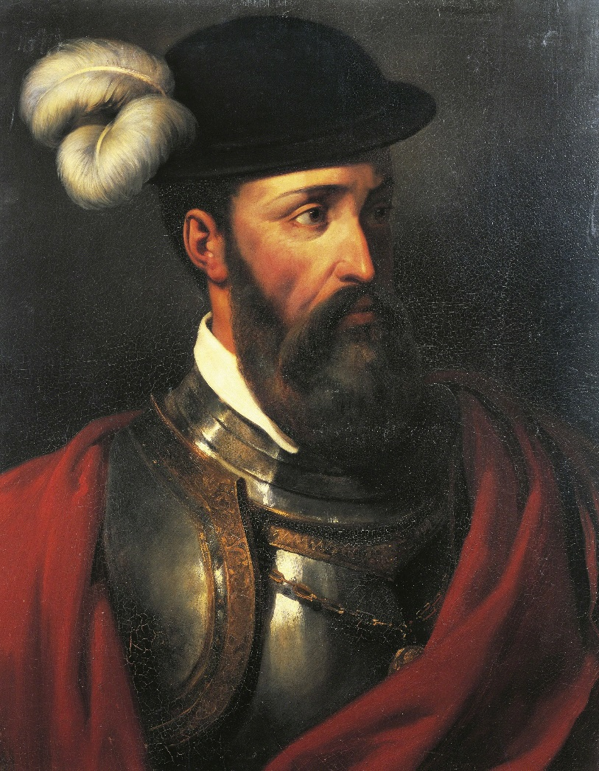
Two outstanding cases of the use of forensic anthropology to successfully solve unsolved mysteries are the cases of Francisco Pizarro.
Spanish Conquistador

Slide 10
Pizarro conquered the Incas.
Pizarro was hated by the Peruvians because he was a brutal ruler. On June 26, 1541 (at age 66), he was stabbed to death by a crowd of angry subjects and in view of many witnesses (Dickerson 1993).
His brutal death is not questioned due to the well documentation at the time. It was his remains that were questioned.

Slide 11
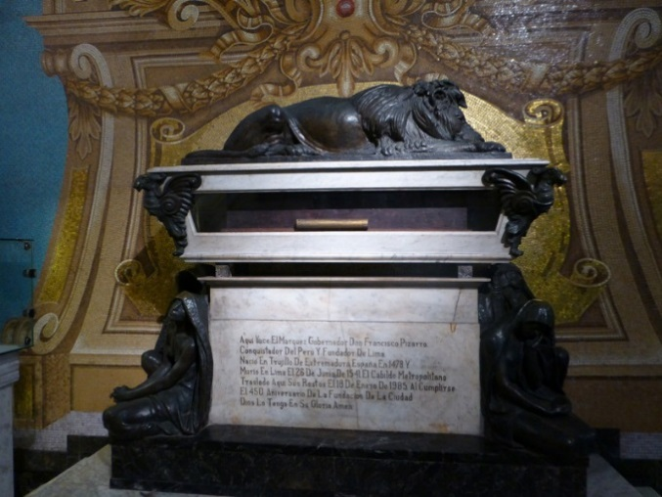
In the 1890's, Peruvian officials decided to put Pizarro's remains on exhibit. "They asked officials at the Cathedral of the Plaza de Aramis in Lima for Pizarro's body and were directed to a mummy, which they put on view." (Dickerson 1993)
In 1978 workers discovered a secret niche that had been walled over in the cathedral, and on a shelf in the niche was a box with a skull and an inscription that identified it as the head of Pizarro.
Another box was found containing the bones of several unidentified individuals (Dickerson 1993).

Slide 12
The Question was, "Who was the real Pizarro?"
An investigation of the bones in the second box led to the discovery that the postcranial bones matched the skull in the first box.
These bones and the skull were then placed together and prepared for study to determine if they had marks consistent with sword or knife wounds.

Slide 13
Who’s the Mummy?
Just by using visual observation, researchers could tell that the skeleton had been stabbed many times, dying in the same way as Pizarro was reported to have died.
The location of the wounds showed that the victim had been stabbed "about the head and body and apparently had tried to shield himself with his arm, a reaction common in stabbing deaths." (Dickerson 1993)
On the other hand, the mummy had no such injuries at all (Dickerson 1993).

Slide 14
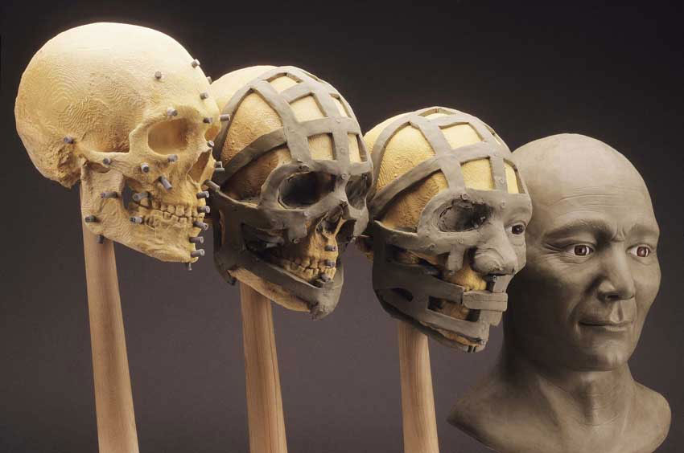
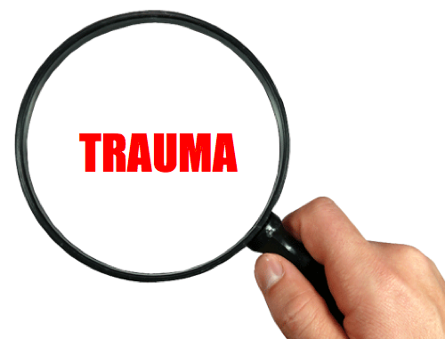
Facial Reconstruction & Types of Traumas

Slide 15
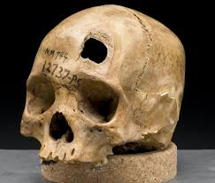
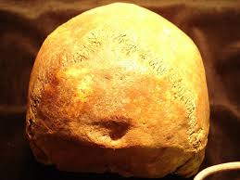
Using Bones to Det. Trauma Type
cause of death can only be inferred by forensic anthropologist
experts will say that observed trauma is consistent with….

Slide 16
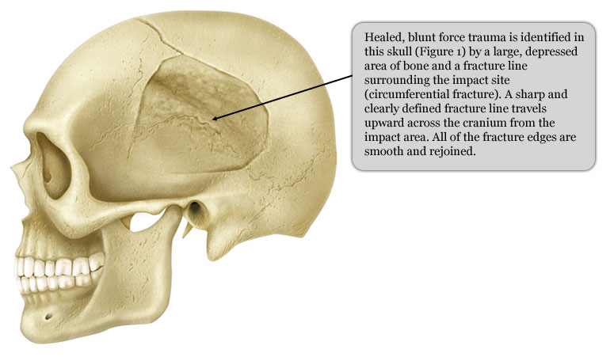
A. Blunt Force Trauma
wide surface area of bone is affected
Fracture lines tend to be simple

Slide 17
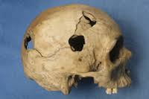
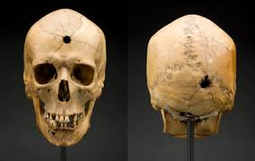
B. Projectile Trauma
wounds exhibit complete displacement (removal) of bone w/ radiating fracture lines

Slide 18
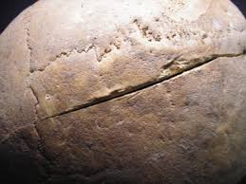
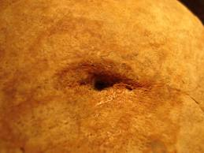
C. Sharp Force Trauma
injury with narrow focus
puncture wounds or grazing cut marks depending on angle of force

Slide 19
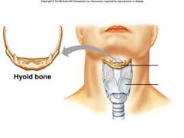
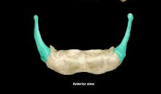
D. Death by Strangulation
34% of strangulation deaths result in broken hyoid (throat) bone
very diff. to determine in kids <20
Throat bones have not fused

Slide 20
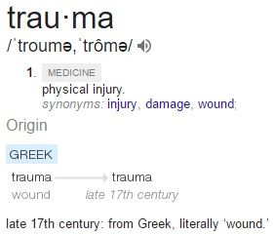
A. Review: 5 classifications of death
Types of Fractures
Natural
Accident
Suicide
Homicide
Unknown
Most likely to cause skeletal injuries/trauma
**Fracture occurs when force exceeds strength of bone!!

Slide 21
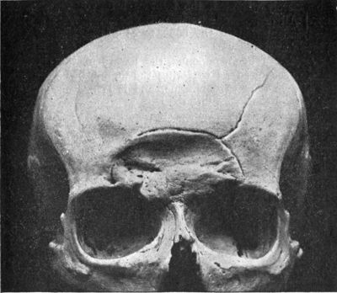
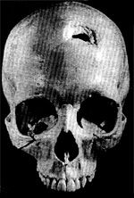
B. 5 Types of Force
Compression
a. force pushes down
b. many lines that
radiate out
c. common on skull/chest
d. shape of displaced bone matches instrument

Slide 22
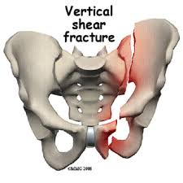
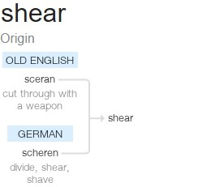
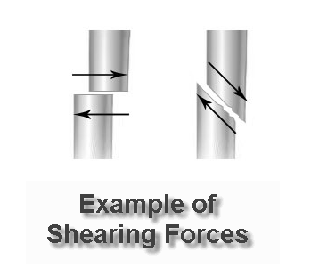
2. Shearing
Force by immobilization of one bone segment
Usually caused by person falling or dismembering

Slide 23
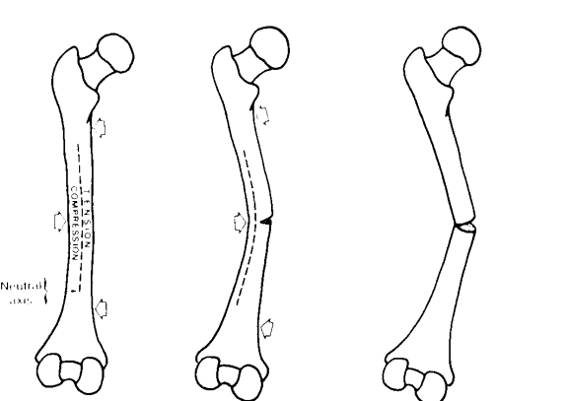
3. Bending
Most common
Force impacts at right angle
Implies violent struggle

Slide 24
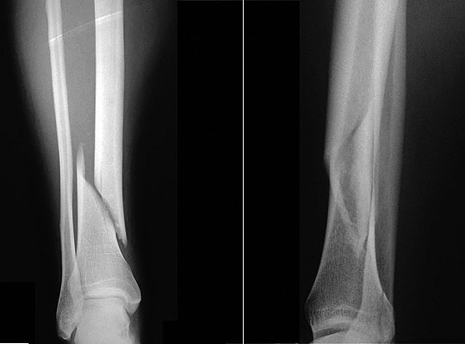
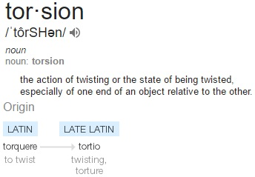
4. Torsion
Twisting force
Accidents (snowboarding)
Child abuse

Slide 25
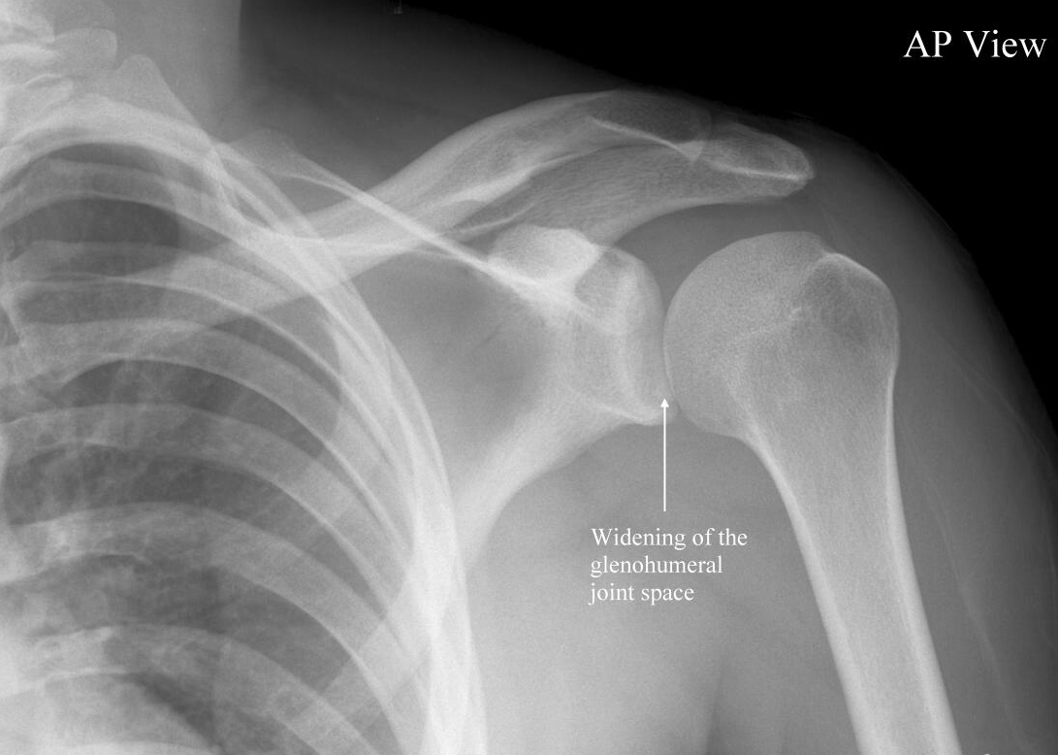
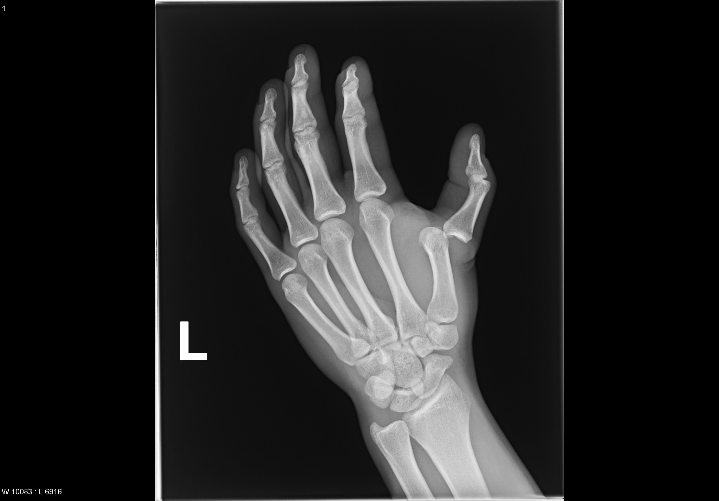
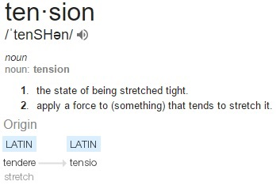
5. Tension
Pulling force
Dislocation
Accidents or violent struggles

Slide 27
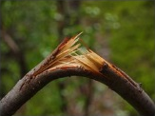
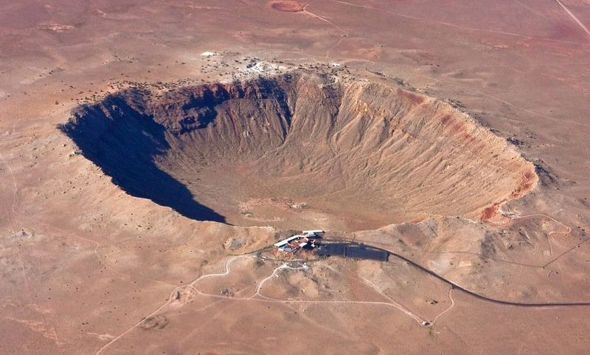

Slide 28
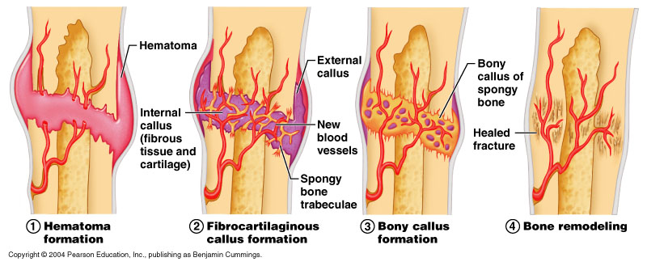
VII. Fracture repair
“bone healing”
To produce new bone w/o a scar, as seen in other tissues, which would be a structural weakness
Hematoma = swelling

Slide 29
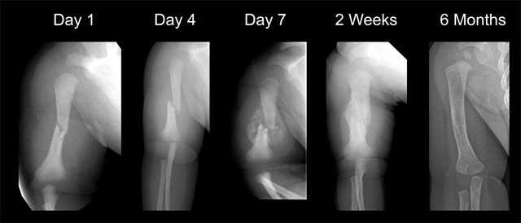

Slide 30
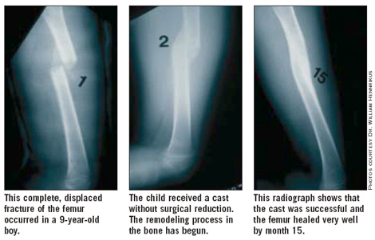

Slide 31
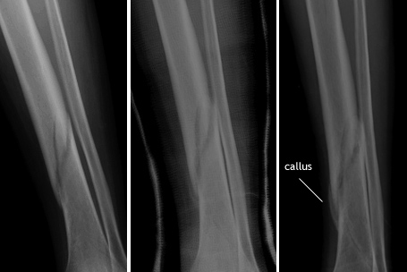

Slide 32
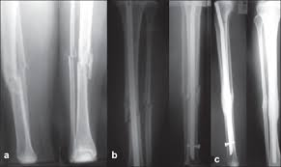

Slide 33
XII. Using Bones to det. Race
A. 3 Race Categories
1. Negroid - “black” incl. Africans, Caribbean, and African-Americans
2. Mongoloid - incl. Chinese, Japanese, Inuit (arctic regions), Native Americans
3. Caucasoid- “white-skinned” or European descent; Europeans, East Indians, Pakistanis, Arabs

Slide 34
B. Analysis of Skull
Skull has greatest number of distinguishing traits among races
Controversial; not very reliable due to intermixing
Only suggestions given; never conclusions

Slide 35
C. Orbit(Eye) and Nasal Region
Race | Orbits | Nasal Cavity
Negroid
Mongoloid
Caucasoid
Rectangular shape
Wide space between eyes
Wider cavity
Base is flared (widens out)
Round shape
Large, prominent nasal spine; Steepled nasal
Sloped downwards

Slide 36
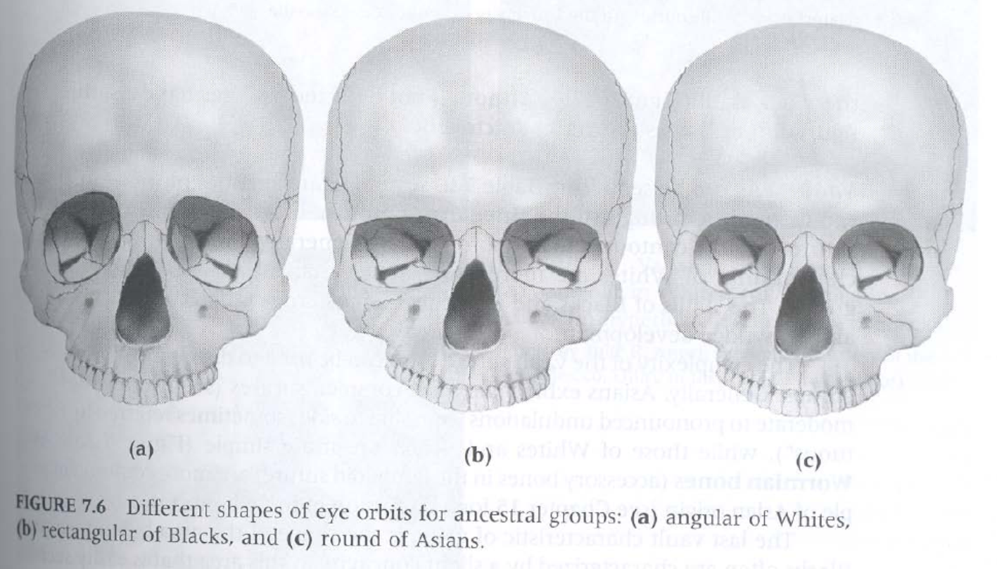

Slide 37
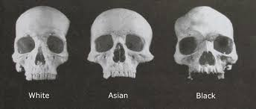
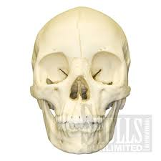
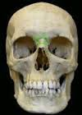
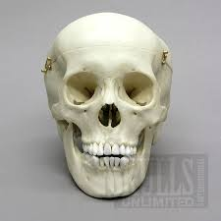
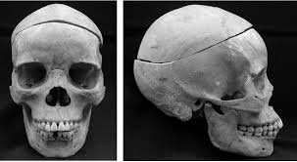

Slide 38
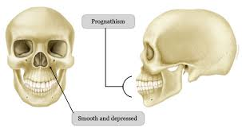
D. Negroid
Has prognathism-mandible at angle
Rectangular orbits

Slide 40
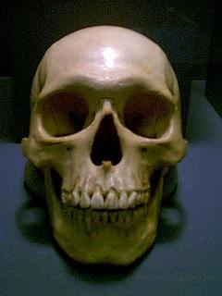
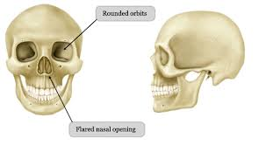
E. Mongoloid
wide cheek bones

Slide 41
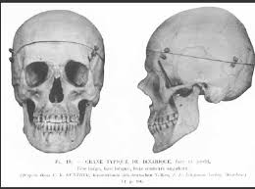
F. Caucasoid

Slide 42
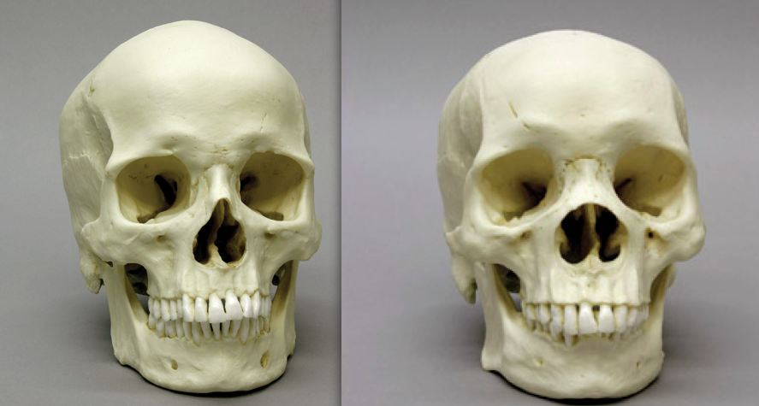
negroid
mongoloid

Slide 43
XIII. Using Bones to det. Age
The younger a person is, the more narrow and accurate the age range
Fetus = most accurate
Factors used and analyzed:
sutures of the skull (a.k.a. cranial suture lines)
development of teeth
ribs
vertebrae
growth areas of the long bones: epiphyses

Slide 44
A. Sutures of the Skull
When a baby is born, the skull is still growing.
To accommodate growing baby, the different bones of the skull are separate.
By 7, the different bones have finished growing and the soft spots have disappeared.
As age increases, suture lines get smaller and smaller

Slide 45
Skull Sutures

Slide 46
B. Teeth
first to appear are incisors, then canines, then molars.
When chewing food, teeth grind down.
Comparing different teeth gives an idea of how long the teeth have been used.
Eventually teeth may be lost, due to disease or attrition.

Slide 47
Teeth
The teeth are arranged in upper and lower arches. Upper is called maxilla; those of the lower is mandible.

Slide 48
Dental Disease - Cavities, Abscesses, and Attrition

Slide 49
C. Ribs
Because of breathing, the front part of the ribs is constantly moving.
As a person gets older, the front part of the ribs begin to change and form bony spikes.

Slide 50
D. Vertebrae
As a person gets older, bony spikes can also start growing on the vertebrae.
This starts at approx. 40 years of age.

Slide 51
E. Growth Plates of long bones
Females: grow til ±15
Males: grow til ±25
Growth occurs at ends of long bones.
Then growth stops; can be seen

