Slide 1
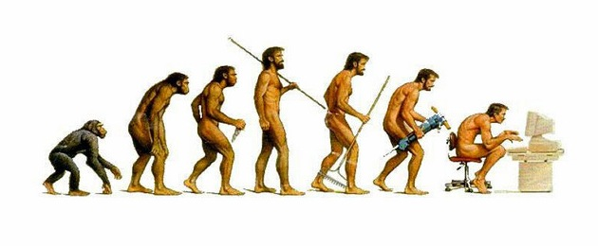
Forensic Anthropology & Bones Intro

Slide 2
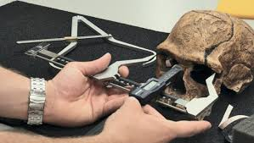
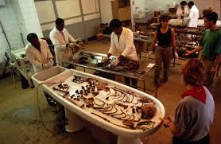
I. What is a forensic anthropologist?
expert in analyzing
someone who applies anthropology (the study of ) to criminal investigations
human remains
humans

Slide 3
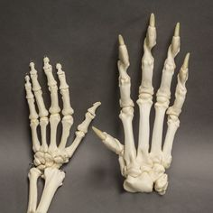
II. What can a forensic anthropologist determine?
if bones are or .
sex
approx. height
approx. age
race
how the person died (trauma, disease, etc.)
general state of health
type of occupation
human
animal

Slide 4
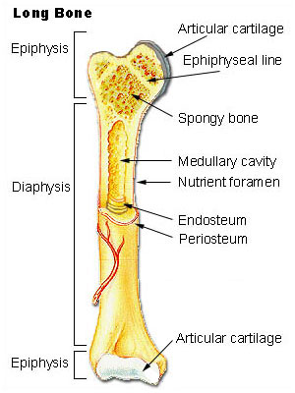
III. Bones
A. What is a bone?
Bones are rigid, connective tissues that makes up the skeleton of vertebrates.
Adults have d bones. At birth there are about .
decrease due to bones .
206
270
fusing

Slide 5
B. Types of Bones
1. Long bones: have greater length than width and consist of a shaft and a variable number of endings
Ex: femur, tibia, fibula, humerus, ulna and radius
2. Short bones: roughly cube-shaped; approx. equal length and width.
Ex: vertebrae, ankle and wrist bones.
3. Flat bones: thin shape/structure and provide considerable mechanical protection and extensive surfaces for muscle attachments.
Ex: cranial bones, sternum, ribs, scapulae

Slide 6
C. Bones provide:
1. Support and movement (limbs)
2. Protection (skull bones, ribs)
3. Mineral storage
4. Blood cell development (long bone marrow)
Bone composition:
65% inorganic matter (hydroxyapetite)
35% organic matter (mostly collagen)

Slide 7
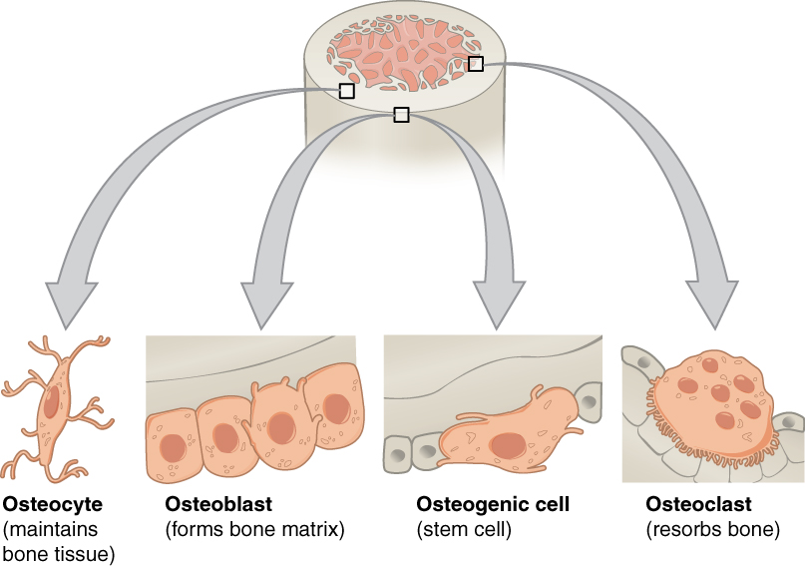
D. Bone cell types
1. Osteoblasts: Make and deposit components of bone (blast = germ, sprout)
2. Osteoclasts: Degrade and resorb bone for remodeling (clast = pieces)
3. Osteocytes: “watcher cells” Sit in bone and monitor mineral concentration (cyte = vessel)
***Bone is alive!! Excellent source for DNA

Slide 8
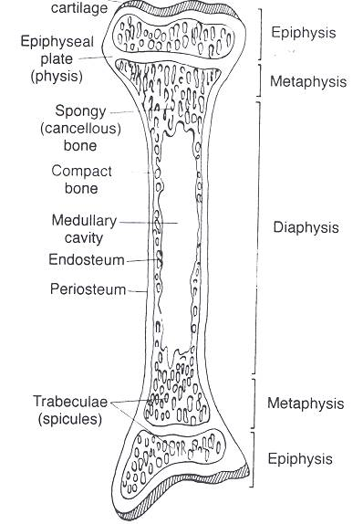
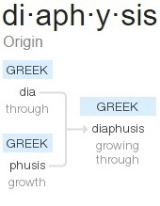
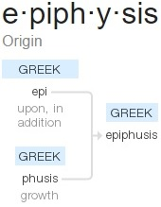
IV. Structure of a Long Bone
Diaphysis (shaft)
Epiphysis
Proximal
Distal

Slide 9
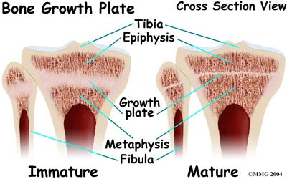
Endosteum-(lines medullary cavity)
(Holes)
Nutrient Foramen
Medullary cavity
Articulating cartilage
Yellow marrow
Epiphyseal plate
(growth plate)
Periosteum
(SLIMY)
Spongy Bone (20%)
Compact bone (80%)
(DRY)

Slide 10
Calculate & Convert Our Height
5 ft. = 60”
6 ft. = 72”
5.6 ½ = 60” + 6.5” =
ME
169 cm
66.5”
≈ 169 cm
66.5
2.54 cm
=
168.9
1 inch

Slide 11
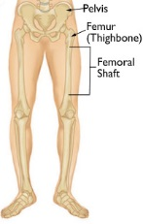
Femoral Diagram
ME
41 cm
169 cm

Slide 12
Calculate & Convert Our Height
5 ft. = 60”
6 ft. = 72”
5.6 ½ = 60” + 6.5” =
ME
41 cm
3 boys, 3 girls
Incl. yourself
169 cm
66.5”
≈ 169 cm
66.5
2.54 cm
=
168.9
1 inch

Slide 13
V. Using Bones to determine species
*Human vs. Animal
Bone Part | Humans | Animals
Cells
Ribs
Limbs
Upper Limbs
Lower limbs
Round
Rectangular/linear
C-shaped; <12
Linear/straight; >13
Children have unfused growth plate
Fused growth plate
Fewer muscle attachment area; straight
More muscle attachment areas; curved
Large trochanter; upper head is angular
Small trochanter; upper head is flat

Slide 14
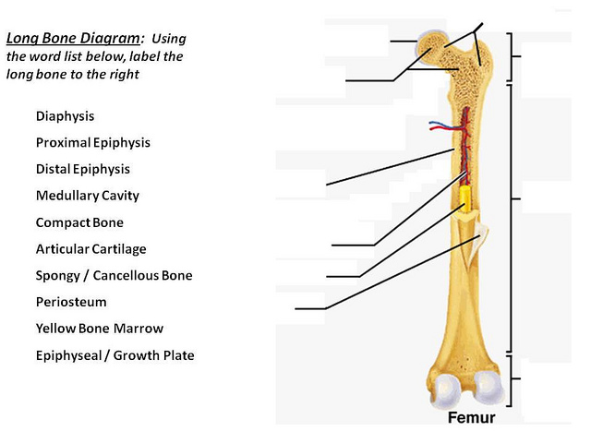
#3
A
L
B
K
J (cavity lining)
1.
C
2.
B
I (holes)
3.
D
H
4.
G
C
5.
H
G (cavity)
6.
L
7.
K
F
8.
E
E
9.
F
10.
A
11.
I
D
Nutrient Foramen
Endosteum
12.
J

Slide 15
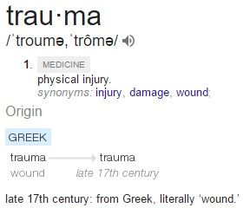
A. Review: 5 classifications of death
VI. Using bones to det. types of fractures
Natural
Accident
Suicide
Homicide
Unknown
Most likely to cause skeletal injuries/trauma
**Fracture occurs when force exceeds strength of bone!!

Slide 16
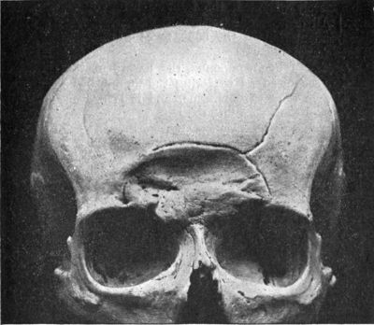
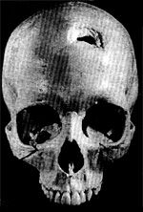
B. 5 Types of Force
Compression
a. force pushes down
b. many lines that
radiate out
c. common on skull/chest
d. shape of displaced bone matches instrument

Slide 17
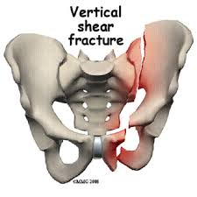
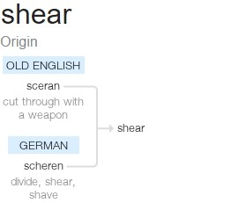
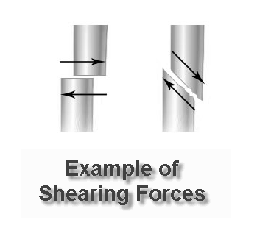
2. Shearing
Force by immobilization of one bone segment
Usually caused by person falling or dismembering

Slide 18
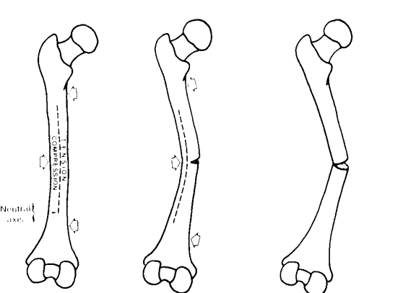
3. Bending
Most common
Force impacts at right angle
Implies violent struggle

Slide 19
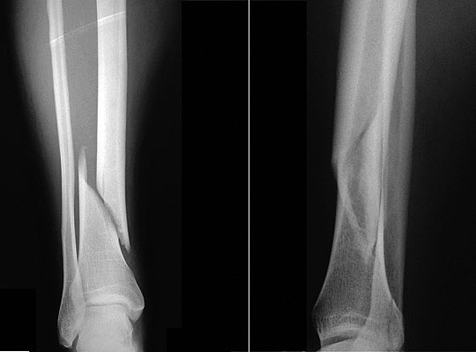
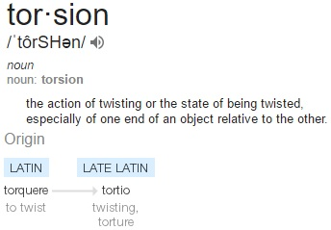
4. Torsion
Twisting force
Accidents (snowboarding)
Child abuse

Slide 20
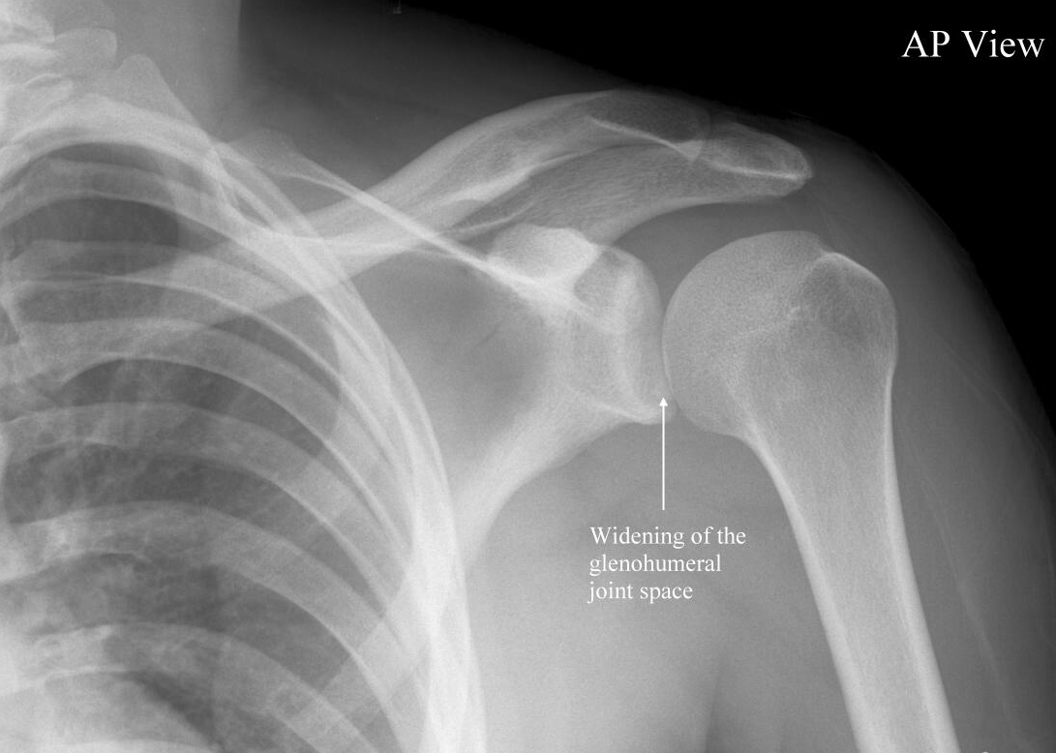
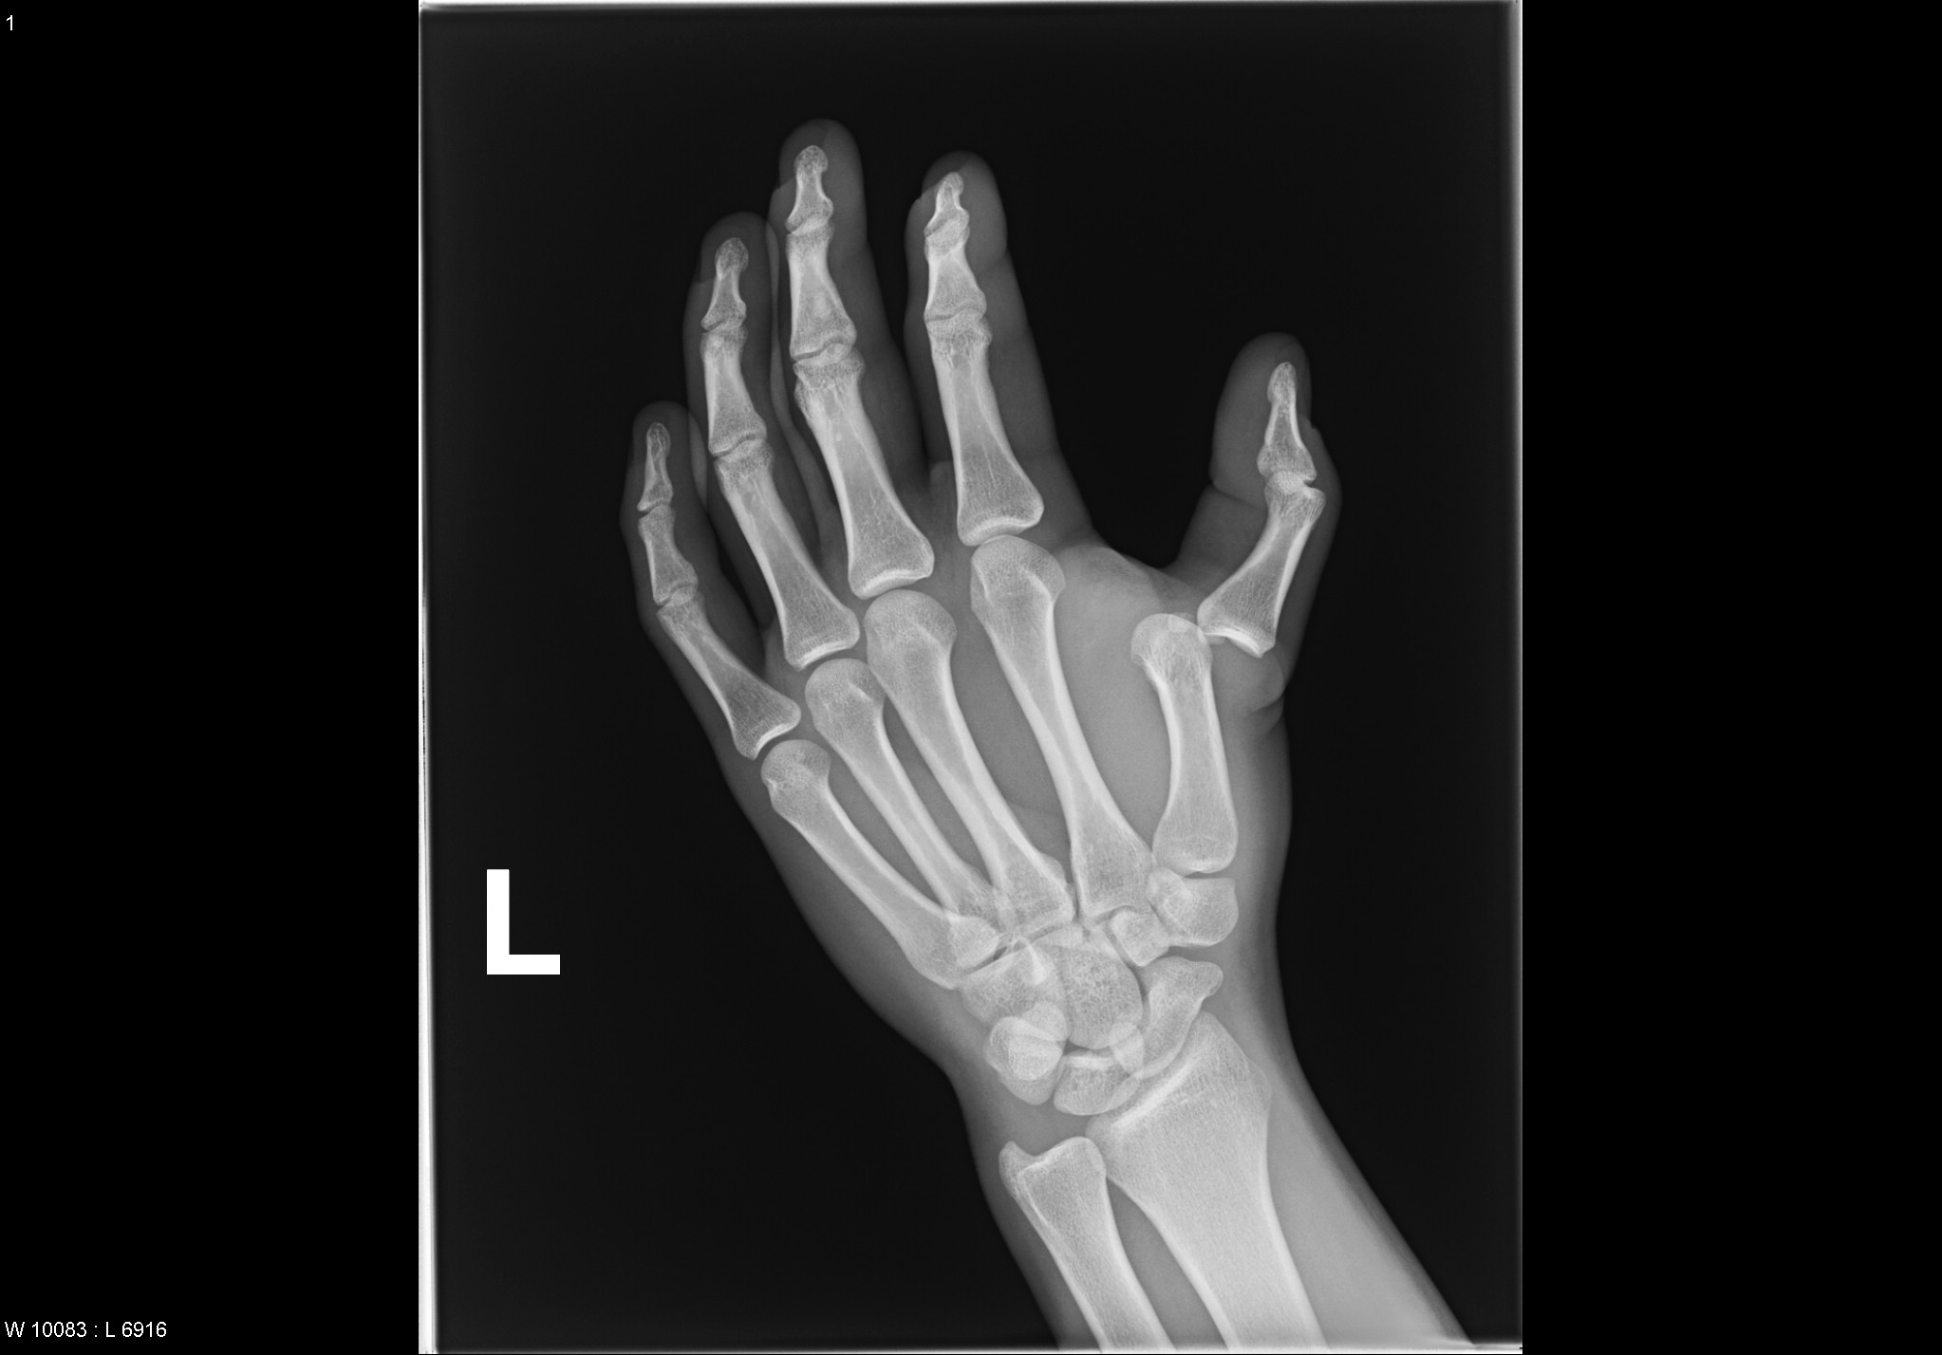
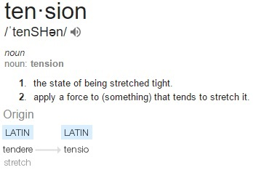
5. Tension
Pulling force
Dislocation
Accidents or violent struggles

Slide 22
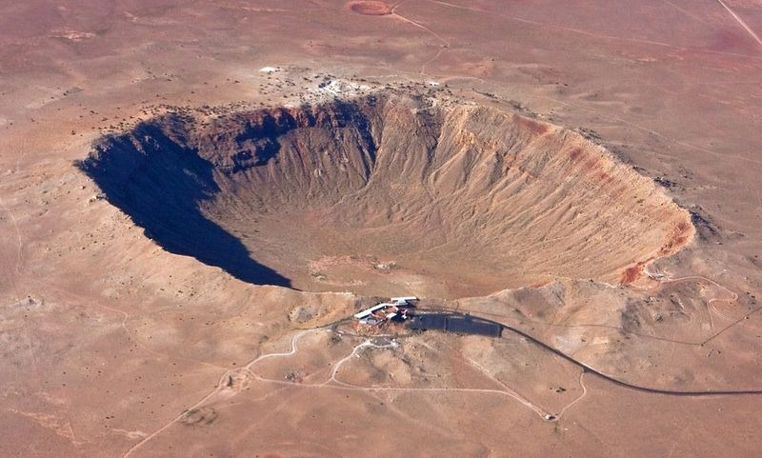

Slide 23
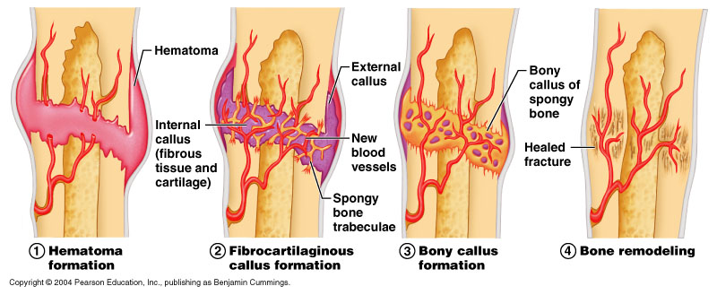
VII. Fracture repair
“bone healing”
To produce new bone w/o a scar, as seen in other tissues, which would be a structural weakness
Hematoma = swelling

Slide 24
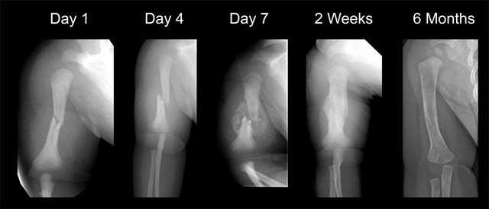

Slide 25
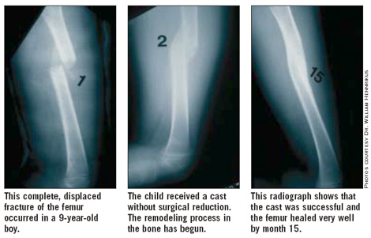

Slide 26
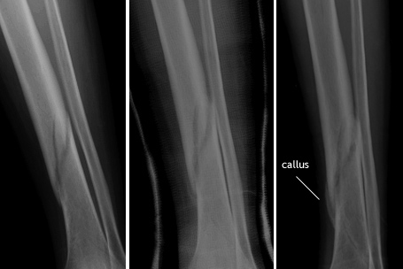

Slide 27
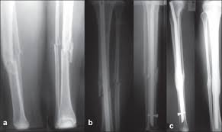

Slide 28
VIII. Determining Sex w/ Pelvis
**Best sex-related skeletal indicator!
Pelvis | MALE | FEMALE
1. Pubic Symphysis
2. Hips
3. Pubic Inlet
4. Coccyx
V-shaped pubic arch (<90°)
U-shaped pubic arch (>90°)
Vertical
Wider (“flared out”)
Heart-shaped
Circle
Larger, less curved
Smaller, more curved

Slide 29
Intro
Nearly impossible to do in children <12
Diff’s b/w sexes arise from hormones & biological functions

Slide 30
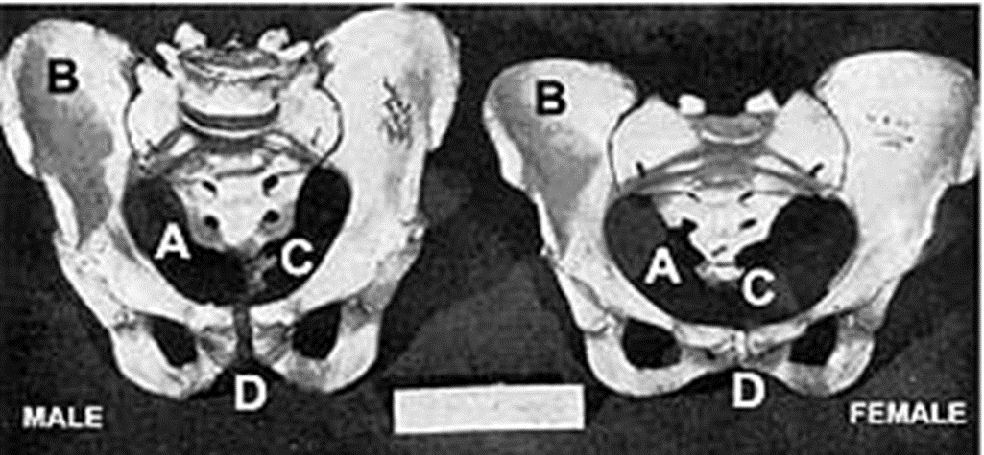
A. Analyzing the Pelvis (~95%)
1. Pubic symphysis angle

Slide 31
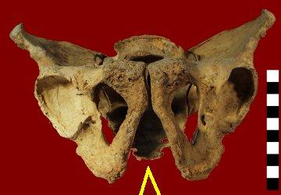
Male Pelvis Subpubic Notch

Slide 32
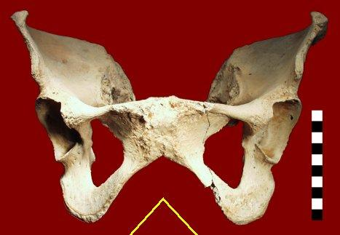
Female Pelvis Subpubic Notch

Slide 33
2. Hips (vertical vs. wide)

Slide 34
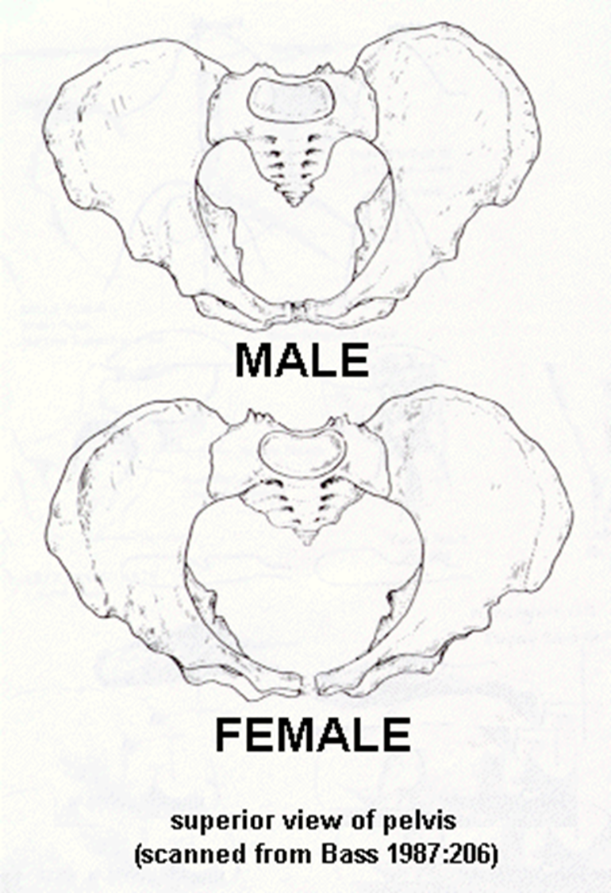
3. Opening between hips (heart vs. circle)

Slide 35
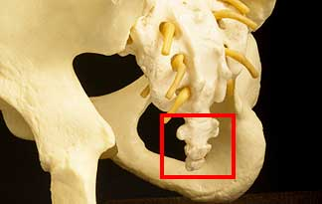
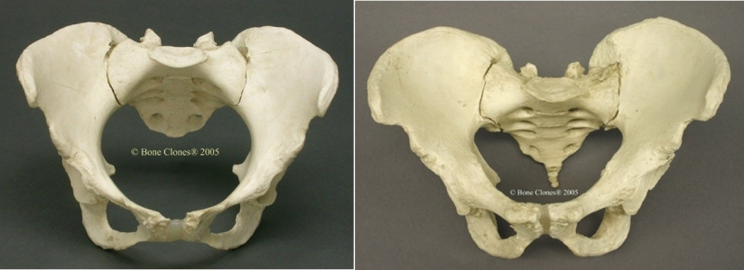
4. Coccyx-smaller vs. larger

